Slide 1
Group 14
Alex Polley, Ryan Manthorp, Daniel Pokladek, Tom Mclaren

Slide 2
Logline
A librarian, a bookshop in space, alien bookworms trying to destroy history, Kill worms to save earth

Slide 3
Emotions/ Introduction
Monachopsis
Achieved by having subtle hints that this bookshop is out of place
Vellichor
Achieved by showing vintage décor and artwork of bookshop

Slide 4
What does the player do?
The player will be moving books with the mouse
Player will sort books in chronological order and size
The player will also shoot enemies/ worms with lasers

Slide 5



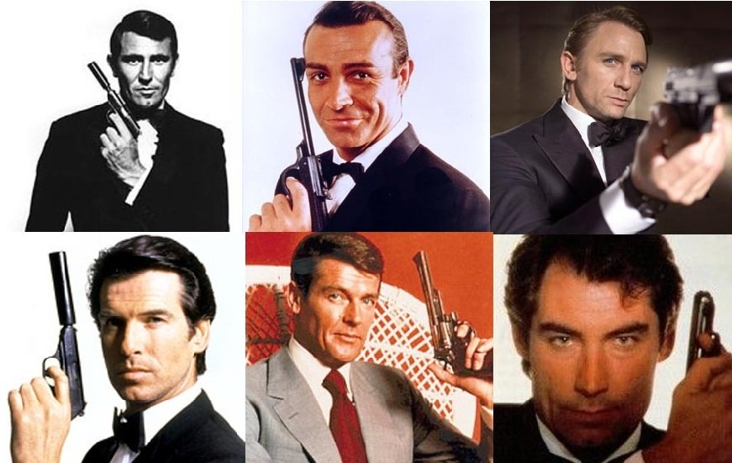
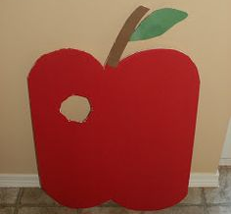
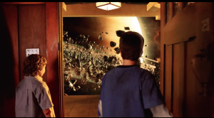

Moodboards
The burnt slow destruction of time and history
Missing countries of the world
Incorrect order
Missing segment (eaten by worm)
Realisation you’re no longer on earth (Zathura Movie Scene)
Unorganized chaos (no order)

Slide 6
Mechanics

Slide 7
Art Style
The art style is still yet to be decided
The style will however be consistent in various assets throughout the game

